Slide 1
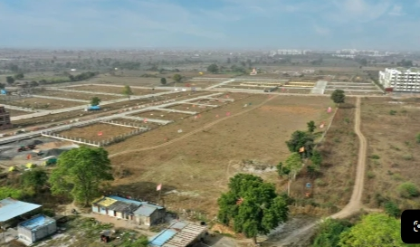
SMART VILLAGE PORTAL
Academic Year 2025–2026
Smart Village - Mana Grama Abhivruddhi
Building Stronger Rural Communities
Empowering villages through Education, Cleanliness, and Infrastructure for sustainable growth.
Ram Gopal
Syam
Lakshimi
Sarojini
Rama

Slide 2

CONTEXT & CHALLENGES
Introduction & Problem Statement
Slide 02
Rural Development Needs
Education Gap
Swachh Tracking
Limited access to digital learning & scholarships.
Manual cleanliness and waste management drives.
Villages require streamlined access to education, sanitation, and public infrastructure. Current systems lack a centralized digital hub for citizens and governance.
Centralized Platform: Single access point for services.
Roads & Water
Scattered Data
Community Empowerment: Fast, transparent participation.
Delayed grievance resolution for basic utilities.
No single dashboard for village stats and updates.

Slide 3
CORE PROGRAMS & ARCHITECTURE
Proposed Solution — Mana Grama Abhivruddhi
Slide 03
Education
Swachh Village
Roads & Water
Quality learning, digital classrooms, scholarships, and youth empowerment.
Cleanliness drives, waste management, sanitation, and hygiene programs.
Improved rural roads, safe drinking water, and conservation solutions.
SYSTEM DATA FLOW PIPELINE
Citizens
Web Portal
Database Engine
Admin Portal
Smart Village Admin

Slide 4
SYSTEM CAPABILITIES
Technologies & Main Features
Slide 04
Technology Stack
Admin Dashboard
Help & FAQ Section
Frontend
CRUD control for projects, complaints & users.
Interactive guidance & program inquiries.
HTML5, CSS3, JS, Bootstrap
Backend
Node.js Framework
Responsive UI
Auth & Session
Tailored desktop, tablet & mobile experience.
Secure password hashing and token sessions.
Database
MySQL / MongoDB Relational Store

Slide 5

IMPACT & VISION
Conclusion & Future Scope
Slide 05
Mobile App
GIS Mapping
Conclusion
Native Android & iOS releases.
Interactive village resource maps.
Mana Grama Abhivruddhi serves as a unified digital platform for rural governance, elevating access to Education, Swachh drives, and Roads & Water management.
AI Service Bot
IoT Agriculture
Multilingual support assistant.
Telemetry & irrigation telemetry.
"Building Stronger Rural Communities"
THANK YOU!

Slide 6

Mana Grama Abhirudhi Website
Website link: https://effulgent-stardust-d9e63e.netlify.app
Thank you
Any queries
t

